Slide 1
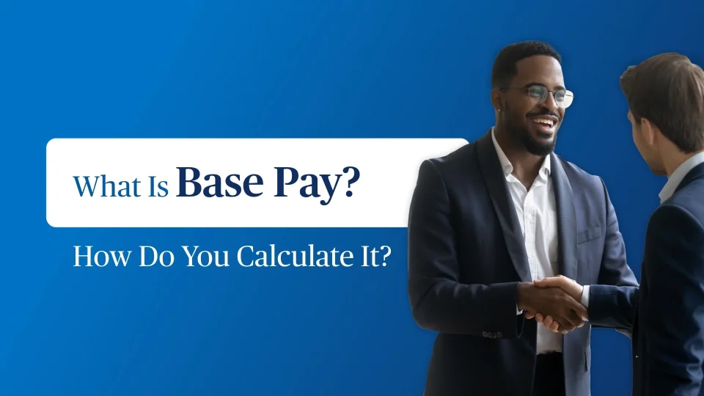
Base Pay

Slide 2

Designing A Base Pay
Structure
After determining internal equity relationships among jobs, and
Identifying competitive pay practices in the market place,
The next order of business is the design of a pay structure.

Slide 3
Designing A Base Pay
Structure
The Architects of the Pay Structure Must:
  Establish a pay policy line.
  Design pay grades using pay grade minimum and maximum and desired spreads of the range.
  Determine overlap between pay grades.
  Determine if the organization needs more than one pay structure and why.

Slide 4

Compensation Policy Guidelines
Decisions that provide guidelines for the compensation manager to follow in developing a pay structure are made at the highest levels of the organization.

Slide 5
Compensation Policy Guidelines
THESE POLICY DECISIONS INCLUDE:
Minimum and maximum levels of pay.
The general relationship among pay levels.
Whether or not the pay structure should lead or lag or lag\lead the market.
The division of the total compensation dollar.

Slide 6

Compensation Policy Guidelines
Additionally
Senior management decides how best to administer its pay policies. How much, to whom, when, where and how.

Slide 7
Pay Structure Design
Questions and Issues
What is the lowest rate of pay that can be offered and still hire desirable employees ?
What is the rate of pay necessary to retain employees ?
Will the organization want to recognize seniority and merit through the base pay schedule ?

Slide 8
Pay Structure Design
Questions and Issues
Is it wise or necessary to offer more than one rate of pay to employees performing either identical or similar kinds of work ?
What is considered to be a sufficient difference in base rates of pay among jobs in a class-series that requires varying levels of knowledge, skills, responsibilities, and duties?

Slide 9
Pay Structure Design
Questions and Issues
Does the organization wish to recognize dangerous working conditions in its base pay schedule ?
Should there be a difference in changes in base pay progression opportunities among jobs of varying worth ?

Slide 10
Pay Structure Design
Questions and Issues
Do employees have a significant opportunity to progress to higher level jobs ? If so, what should be the relationship between promotion to a higher job and changes in base pay ?
Will policies and regulations permit incumbents to earn rates of pay higher than established maximums and lower than established minimums? What should be the reasons for allowing such deviation ?

Slide 11

Pay Structure Design
Questions and Issues
How will the pay structure accommodate across-the-board, cost-of-living, or other adjustments not related to employee tenure, performance, or responsibility and duty changes ?

Slide 12
Pay Structure Architecture
With the generation of internal and external pay data and information, managers are now ready to design a pay schedule.
To do so they must:
  Determine a trend or pay policy line.
  Decide on the need for one or more pay structures.

Slide 13
Pay Structure Architecture
  Display job data
  Establish the characteristics of the pay structure (number, width, and height of pay grades, and overlap)
  Lock overlapping pay structures (when using more than one)

Slide 14
Determining A Pay Policy Line
Each organization must develop its own pay policy line, which is a trend line or line of best fit that best represents the middle value of jobs that have been evaluated or classified to have particular worth.

Slide 15
Determining A Pay Policy Line
The procedure most organizations follow in establishing a pay policy or trend line is to identify the market rates for various benchmark jobs that cover the entire spectrum from lowest to highest rates of pay.
By plotting on a chart the pay-rate information obtained through surveys, a scatter diagram or scatter plot can be developed.

Slide 16
Determining A Pay Policy Line
Different procedures are available for developing a trend line from a scatter diagram...Line of sight...Two-point...
And the least squares methods.
Another simple procedure is to obtain the market rate or going rate of pay for the lowest and highest paid jobs. Connecting these points can also provide a first approximation for a pay policy line.

Slide 17
Determining A Pay Policy Line
Many organizations use the pay policy line to set midpoint values for all their jobs.
Pay policy lines are useful when plotting survey data and comparing them with the internal pay structure.
From the pay policy line, organizations establish the minimum and maximum pay levels, the relationship between pay grades, and the range of a pay grade.

Slide 18
The Need For More Than One Pay Structure
There are a number of logical and rational considerations for having multiple pay structures that focus on the forces that influence the actual pay of the various occupational groups comprising most organizations.

Slide 19
The Need For More Than One
Pay Structure
A major reason for using multiple pay structures is that rates of pay for more advanced jobs increase geometrically rather than linearly.

Slide 20

The Need For More Than One
Pay Structure
It is not unusual for large organizations to have at least three pay structure lines:
  Blue collar manual labor, craft, and trade workers.
  Nonexempt white collar salaried workers.
  Managerial, administrative, and professional exempt employees.

Slide 21

The Need For More Than One
Pay Structure
Some organizations have a fourth pay structure for their highly paid executives.

Slide 22
Displaying Job Data
Even when there is an apparent need for more than one trend line or pay policy line that would lead to more than one pay structure, there is a statistical procedure for avoiding multiple structures.

Slide 23
Displaying Job Data
This procedure allows pay data to be presented by means of some form of curvilinear relationship rather than a relationship that must be a straight line.
A pay structure using arithmetic progression will produce a straight pay police line.

Slide 24
Displaying Job Data
Geometric progression where pay rates vary by some constant rate of increase will produce a curved pay policy line.
To display a geometric progression in a straight line a logarithmic scale is used.

Slide 25
Displaying Job Data
Two values of central tendency most used in analyzing pay relationships are the:
  Mean
  Median
When the market value or going rate of a job is being determined, the average value or mean is frequently the value selected.

Slide 26
Displaying Job Data
But it is not always the best choice...
In the final analysis it depends on the distribution of the data.

Slide 27
Identifying The Lowest And Highest Rates Of Pay
In identifying the lowest rate of pay it is important to pay attention to:
  Legal requirements.
  The prevailing union scales in local markets.
  All area wage scales.

Slide 28
Identifying The Lowest And Highest Rates Of Pay
A high low-end rate pushes all rates too high.....And a low low-end rate promotes to much turnover.
Highest rates of pay are a more subjective consideration.

Slide 29
Identifying The Lowest And Highest Rates Of Pay
The highest and lowest average values should be the midpoint of the pay for those jobs assigned this rate when there is a range of pay available for each category.

Slide 30
Determining Progression From Lowest To Highest Pay Rate
The basic design criterion that determines pay differences in moving through a pay structure is the midpoint-to-midpoint differences.
Midpoint-to-midpoint pay difference is the percentage change in the middle value from one adjacent pay grade to the next.

Slide 31
Determining Progression From Lowest To Highest Pay Rate
Midpoint-to-midpoint pay progressions range from as low as 3% to as high as 25%. and possibly higher is some cases.

Slide 32
Determining Progression From Lowest To Highest Pay Rate
Normally, low midpoint-to-midpoint differences are found in pay structures of lower-paid, unskilled, semiskilled, and clerical employees.
High differences are found in pay structures of the executives and the senior managers of an organization.

Slide 33
Determining Progression From Lowest To Highest Pay Rate
The following issues should be considered when determining the appropriate midpoint-to-midpoint differences:
  The smaller the difference between midpoints the more pay rates available to assign to a specific job.
  The more rates of pay the more opportunity for assigning different rates of pay to jobs with minor differences.

Slide 34
Determining Progression From Lowest To Highest Pay Rate
The greater the differences between pay rates the easier it is for jobholders to perceive differences in worth between jobs.
A small difference between midpoints may force an organization to have more than one pay structure.

Slide 35
Determining Progression From Lowest To Highest Pay Rate
For jobs at the lower end of the pay structure, a 6% to 7.5% difference in midpoints may be appropriate;
For those in the middle of the pay structure an 8% to 10% difference would typically apply; and
At the executive end of the structure the difference would normally range from 15% to 25%.

Slide 36
Developing Pay Grades
Pay grades are nothing more than convenient groupings of a wide variety of jobs or classes similar in work difficulty and complexity requirements but possibly having nothing else in common.

Slide 37
Developing Pay Grades
It may provide for a single rate, or it may allow for a range of pay within a certain grade.
The top or maximum rate of pay of a pay grade states that this is the most that work produced by a job in this grade is worth to the organization.
The bottom places a minimal value on the contributions of the assigned job.

Slide 38
Developing Pay Grades
The distance between minimum and maximum recognizes the range of performance and experience of incumbents in the assigned job(s).

Slide 39
General Characteristics
Of Pay Grade Systems
Each grade provides for a range of pay.
Within a pay grade range there is a minimum, a midpoint, and a maximum pay.
The range from the minimum to the maximum within a single pay grade may vary from 20 to 100 percent. The most common range is from 30 to 50 percent.

Slide 40
General Characteristics
Of Pay Grade Systems
The number of steps within a grade may also vary. Grades having steps will normally have from 3 to 10 steps, with 6 to 7 in-grade steps most common.
There is a direct relationship between the rate of increase per step and the number of steps within a grade.

Slide 41
General Characteristics
Of Pay Grade Systems
The midpoint of each pay grade is normally a constant percentage greater than the one preceding it. This percentage normally varies from 5 to 10 percent.
Adjoining pay grades normally overlap. If there is a 30 percent range within a pay grade and there is a 10 percent difference between midpoints, there will be a 67 percent overlap.

Slide 42
General Characteristics
Of Pay Grade Systems
The requirements of the organization will provide answers to the correct number of grades, the number of steps within grades, and their rates of progression within and between grades.

Slide 43
General Characteristics
Of Pay Grade Systems
The number of pay grades to be included within a pay structure varies with the circumstances--there is no right number.

Slide 44
Pay Structure Terms
Single-Rate Pay Grade
  A flat rate structure that appears in organizations in which pay rate negotiations between management and unions are common practice, in some small organizations, or in industries using skilled craftworkers.

Slide 45
Pay Structure Terms
Multiple-Point Pay Structure
  Some organizations that use point-factor job evaluation plans establish a rate of pay for every possible point score.

Slide 46
Pay Structure Terms
Broadbanding
  The grouping of jobs of significant differences or worth or value within one band or pay grade.

Slide 47
Pay Structure Terms
Broadbanding (cont)
  This pay grouping or expanded pay grade may have a range varying from 50 percent to 100 percent and include jobs that have responsibilities and duties that vary in complexity and difficulty and require significantly different knowledge and skills.

Slide 48
Pay Structure Terms
Range or Spread Dimension
  The difference between the upper and lower limits of the grade. It may be expressed in absolute dollar amounts or as a percentage.

Slide 49
Pay Structure Terms
Pay Grade Width
  Procedures for establishing a pay grade width are not as specific or precise as those related to the spread or height of the pay grade.
  When using a point-factor plan, points often are the x axis values.

